Slide 1
DEVELOPMENT OF IOT BASED AUTOMATED CONTROLING OF HOME APPLIANCES USING VOICE RECOGNITION TECHNIQUE
(Phase-1)
Under the guidance of
Mrs. Bansari Deb Majumder
(Head of Department, EIE)
Electronics and Instrumentation Engineering
NARULA INSTITUTE OF TECHNOLOGY

Slide 2
CONTENT
Abstract
Introduction
Components used
Flow Chart
Block Diagram
Description of blocks
Advantages of Home Automation System
Conclusion
Acknowledgement
References

Slide 3
ABSTRACT
In today’s world Automatic systems are being preferred over manual systems.
Internet of things is a growing network of everyday object-from industrial machine to consumer goods that can share information and complete tasks while you are busy with other activities.
The aim of this project is to design and implement home automation on the basis of voice recognition.
The project is implemented in hardware and software components that interact through WIFI(wireless fidelity) connections.
An ESP8266 WIFI module, relay and a mobile phone with an Android platform running on top of it are the hardware and software used.

Slide 4
INTRODUCTION
Home automation system is a means that allow user to control electric appliances of various kind. Many existing well established home automation systems are based on wired communication . This does not pose a problem until this system is planned well in advance and installed during the physical construction of a building. But for already existing buildings, the implementation costs go very high. In contrast wireless system can be great help for technologies such as WIFI , cloud networks which are wireless systems and are used everyday everywhere.

Slide 5
Components Used
ESP8266 NodeMCU WIFI Development Board
REES52 Opto-coupler 4 Channel 5V Relay Module Relay
Bulb Holder
Wire(5m)

Slide 6
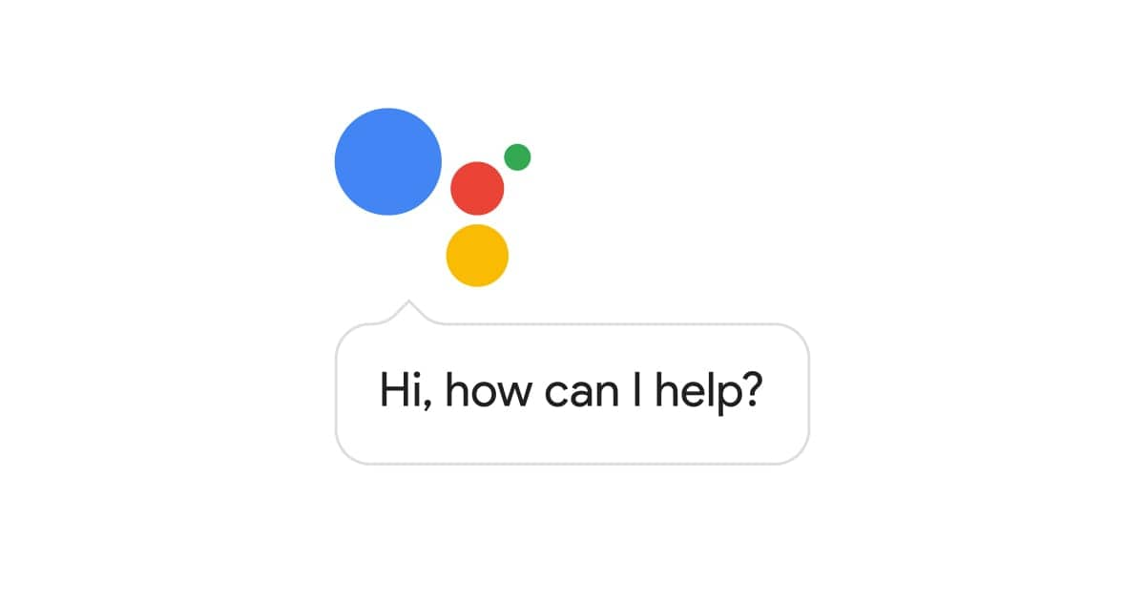

Google Assisstant
Blynk

Slide 7
Flow chart
IFTTT
(Google Assistant)
Blynk
NodeMCU
Relay
Home Appliances
(bulb, fan)

Slide 8
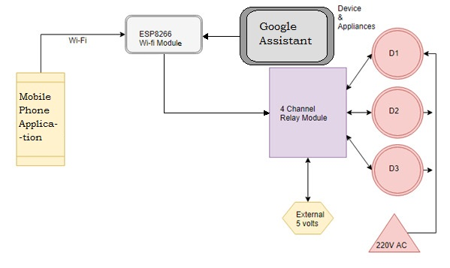
BLOCK DIAGRAM

Slide 9
Description of blocks
Mobile application : Using this (blynk) application we can control the switches accordingly.
NodeMCU (Esp8266) : the command from mobile application or Google assistant (through blynk cloud ) is being processed accordingly and this signal is transmitted to relay.
Relay: it acts like a switch .It receives input from NodeMCU to respective relays(like relay 1, relay 2...). The load is also connected to the load .So if relay is turned on then the load will be activated and vice versa

Slide 10
Advantages of Home Automation System
In recent years, wireless systems like WIFI have become more and
more common in home networking. Also in home and automation
system, the use of wireless systems give several advantages that could
not be achieved using the wired network system only.
Reduced installation cost
Easy extension and installation
User friendly

Slide 11
CONCLUSION
The purpose of the project is to construct an user
friendly wireless home automation system.
The WIFI connection is going to replace the wired
connections that we used to have in our households.
We can switch on and off almost all the in-house
electronic instruments with the help of simple voice
commands.

Slide 12
ACKNOWLEDGEMENT
We would like to express our gratitude to Bansari Deb Majumder (head of the dept.)Electronics and Instrumentation Engineering, Narula Institute of Technology for her valuable guidance which helped us a lot in due course of the project work for PHASE-I.
We would like to thank Bansari Deb Majumder(head of the dept.) Electronics and Instrumentation Engineering, Narula Institute of Technology who had given all the support for performing experiments in this regard.
Finally we would like to thank Bansari Deb Majumder(head of the dept.), Narula Institute of Technology, who extended all the facilities of the department for the project work.

Slide 13
REFERENCES
Charith Perera, Student Member, IEEE, Arkady Zaslavsky, Member, IEEE, “Context Aware Computing for The Internet of Things: A Survey”. IEEE COMMUNICATIONS SURVEYS & TUTORIAL
Bill N. Schilit, Norman Adams, and Roy Want, “Context-Aware Computing Applications”.
Inderpreet Kaur, “Microcontroller Based Home Automation System with Security” at IJACSA) International Journal of Advanced Computer Science and Applications. Vol.1 , No. 6, December 2010.
Paul Jasmin Rani(student member IEEE) ; Jason Bakthakumar Voice controlled home automation system using Natural Language Processing (NLP) and Internet of Things (IoT).
Abdul Aziz Md (lecturer, CSE dept RGUKT,APIIIT ), “cost effective voice control home automation using IOT”.
Design of an Intelligent Voice Controlled Home Automation System Sonali Sen, Shamik Chakrabarty, Ankita Bhaumik, Department of Computer Science, St. Xavier’s College, Kolkata

Slide 14
Thank You

